Slide 1
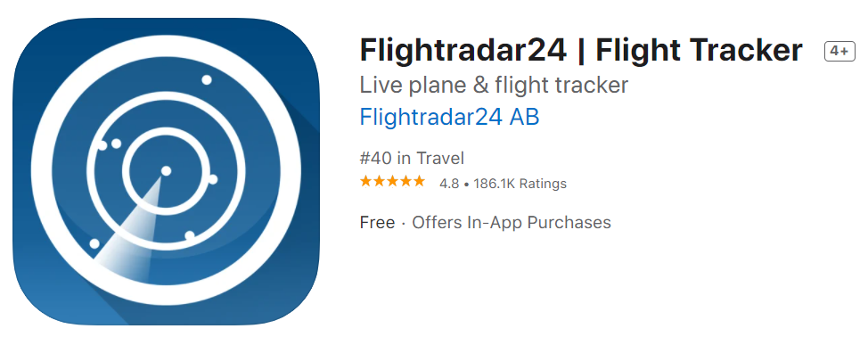
Real trigonometry using real-time, real-world data with the app Flightradar24
Presented by Enzo Vozzo, 1 & 2 December 2022
Mathematics Teacher at Mentone Grammar

Slide 2
$$Learning Intention:$$
$$To calculate and confirm the speed and$$
$$track data of commercial flights from$$
$$the app \text{Flightradar}\text{24 }is correct using$$
$$trigonometry by four different methods.$$
$$Success Criteria:$$
$$I can confirm that the speed and track$$
$$data are correct using four different$$
$$methods from the real−time$$
$$latitude and longitude coordinates.$$

Slide 3
$$The app$$
$$\text{Flightradar}\text{24}$$
$$gives real time flight$$
$$data on commercial$$
$$flights around the world.$$
$$These data include:$$
$$Latitude in decimal degrees$$
$$Longitude in decimal degrees$$
$$Speed in knots (nm per hour)$$
$$1 knot=1 nautical mile/hour$$
$$1 nautical mile=1.852 km$$
$$Altitude in feet$$
$$Track \left(Bearing\right) in °True$$

Slide 4
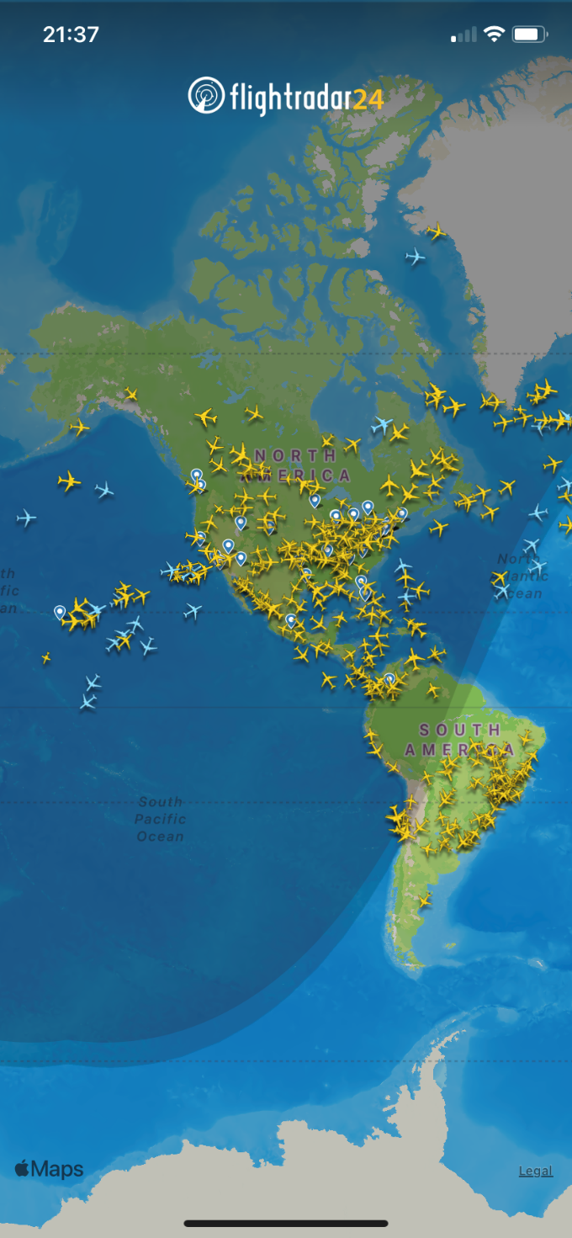
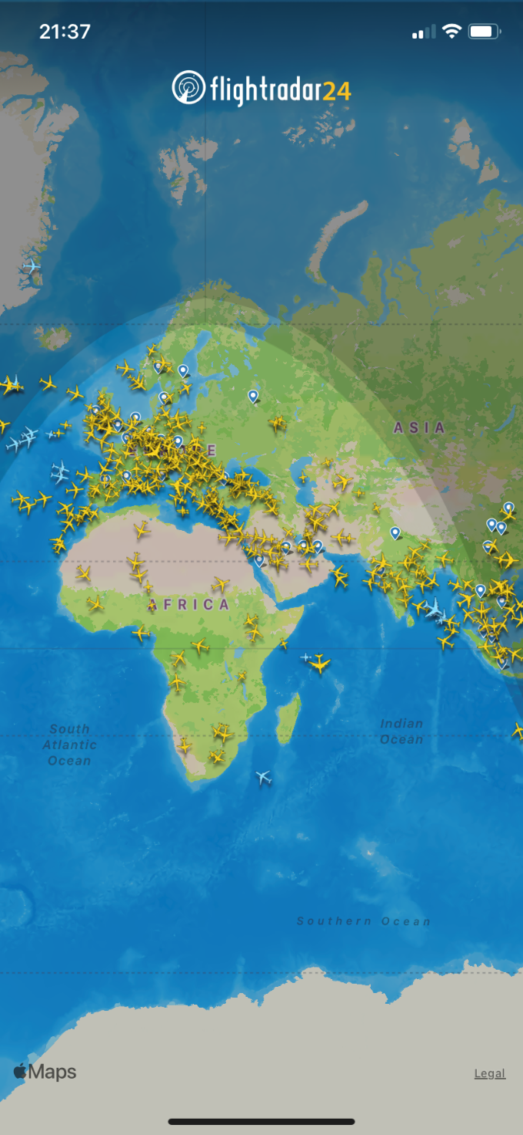
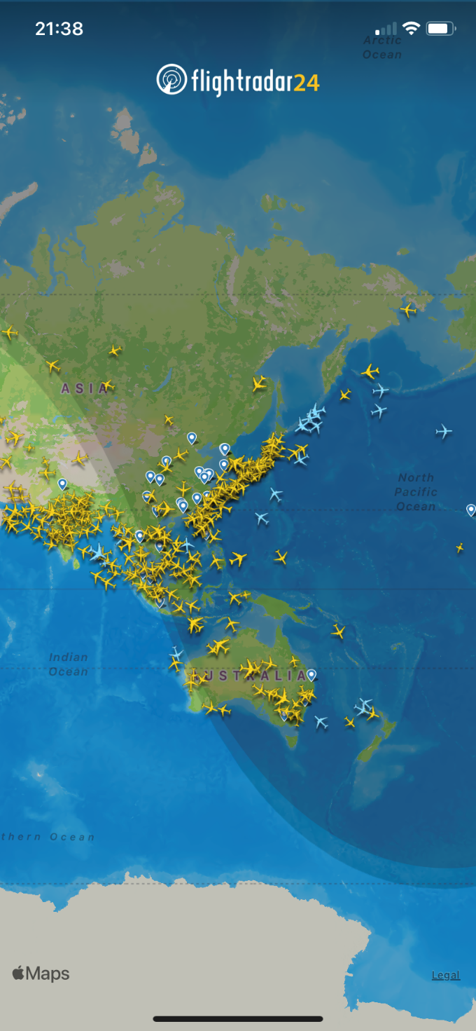
$$Flightradar24$$
$$App icon$$
$$Typical$$
$$views$$

Slide 5
$$The best way to capture these data is with$$
$$a screen recording on your mobile phone.$$
$$During the screen recording, the speed and$$
$$direction of travel must remain constant.$$
$Record approximately 100 seconds or more$to $minimise$
$$errors caused by the one second timing resolution and$$
$$three decimal places of Latitude and Longitude.$$

Slide 6
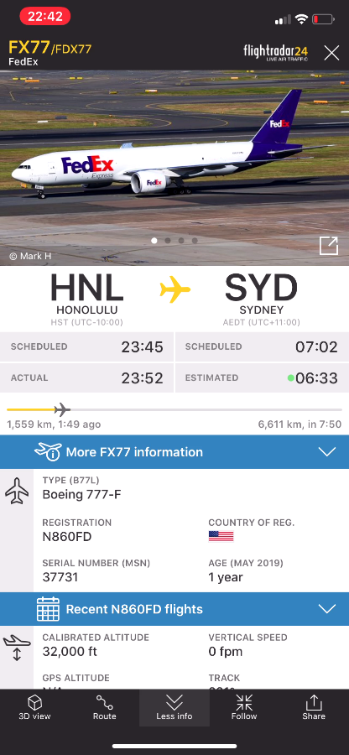
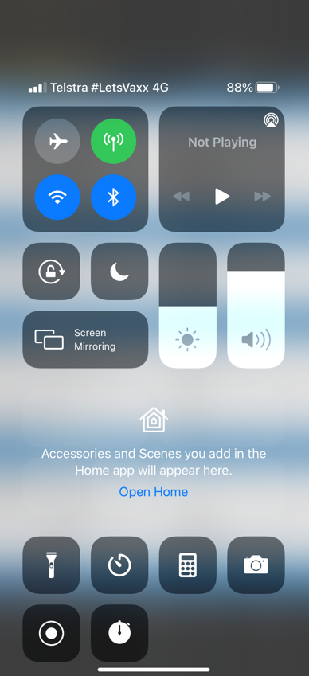
$$Recording a$$
$$flight video$$
$$using an$$
$$iPhone 11$$
$$with iOS 16$$
$$Swipe$$
$$down$$
$$from$$
$$here to$$
$$start and$$
$$end the$$
$$video.$$
$$Screen$$
$$record$$
$$start$$
$$and$$
$$stop$$
$$button$$

Slide 7
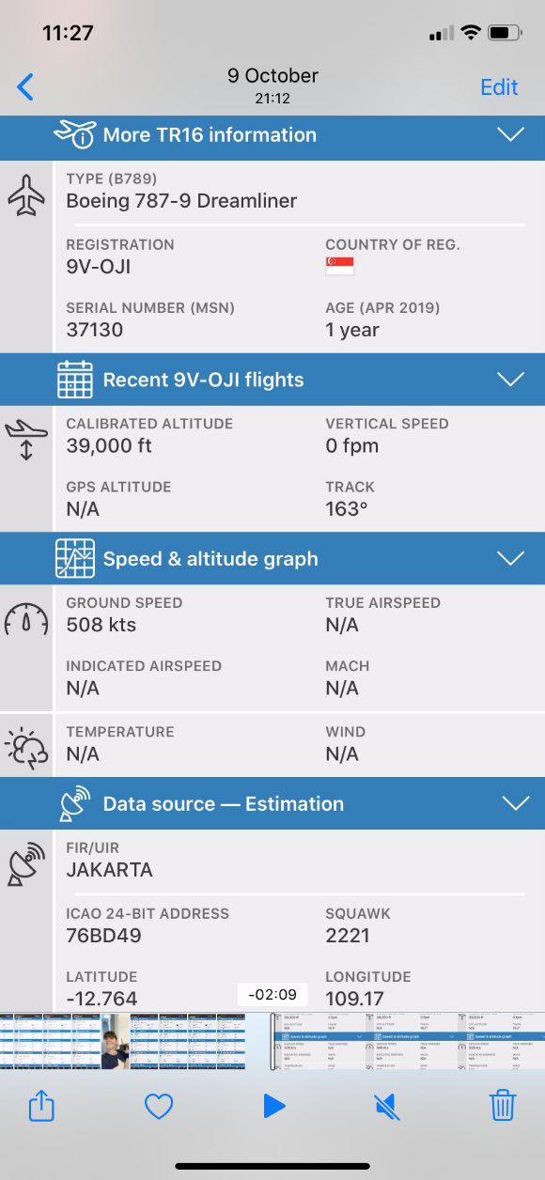
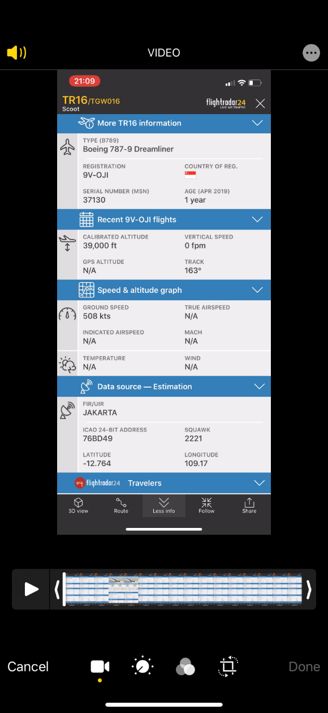
$$Edit video$$
$$To edit video, go to the$$
$$iPhone^{′}s Photo Library.$$
$$This is necessary because$$
$$the screen recorder screen$$
$$needs to be cut from the$$
$$start and end of the video.$$
$$Edit video$$

Slide 8
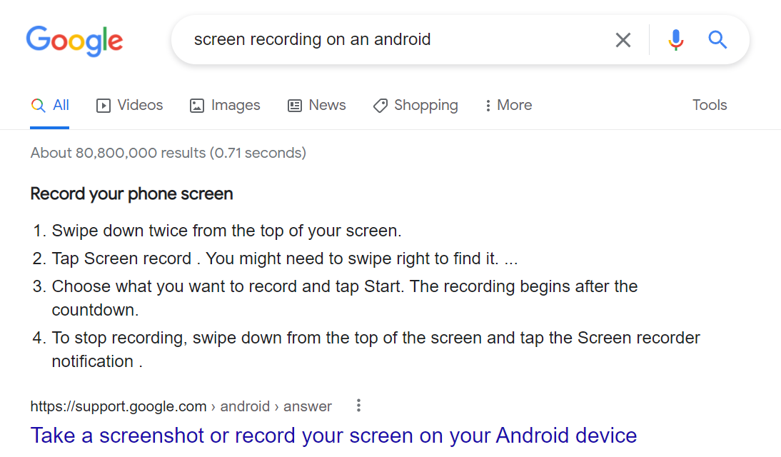
$$Recording a flight video using an Android phone$$

Slide 9
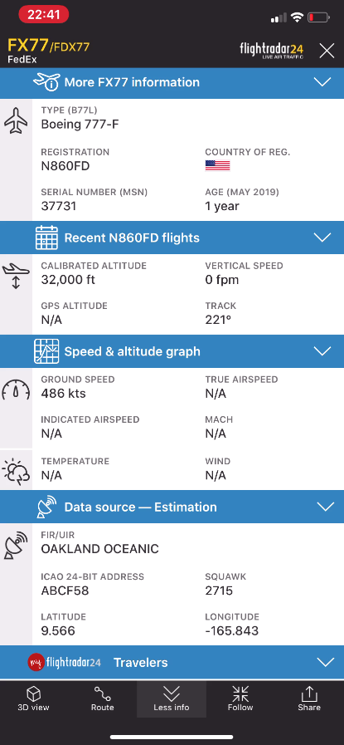
$$Flight$$
$$number$$
$$Altitude in feet$$
$$From$$
$$\&$$
$$To$$
$$Direction of$$
$$travel or bearing$$
$$Speed in knots$$
$$Geographic$$
$$position$$

Slide 10
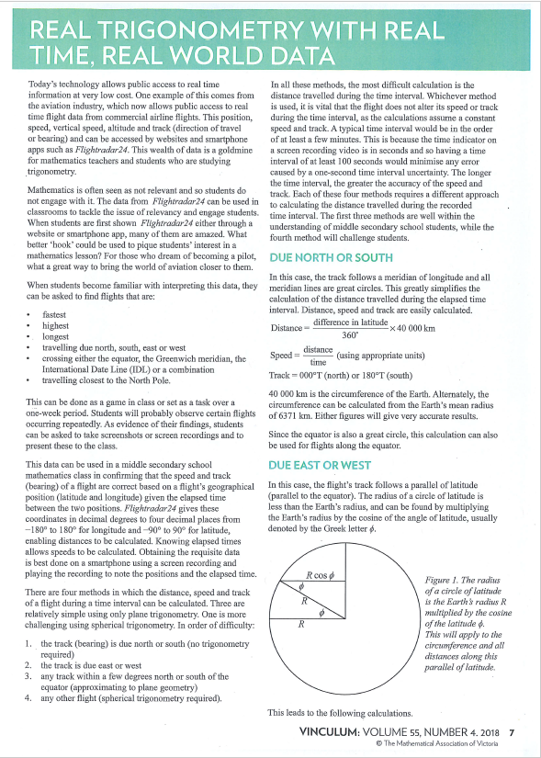
$$This presentation is based$$
$$on the article I published$$
$$in the MAV journal Vinculum,$$
$$Volume 55, Number 4 in 2018.$$

Slide 11
$$The theory$$

Slide 12
$$Geographic$$
$$coordinate$$
$$system$$
$$North Pole:+90°$$
$$+North, −West$$
$$+North, +East$$
$$International$$
$$Date Line:$$
$$±180°$$
$$East or West$$
$$Equator: 0°$$
$$North or South$$
$$Equator$$
$$−South, −West$$
$$−South, +East$$
$$Melbourne$$
$$Lat=−38 S$$
$Long=145$ E
$$South$$
$$Pole:$$
$$−90°$$
$$Prime meridian: 0° (East or West)$$

Slide 13
$$North$$
$$Method 1$$
$$Flight travelling$$
$$due north \left(000°T\right)$$
$$or due south (180°T)$$
$$(No trigonometry)$$
$$South$$

Slide 14
$$90° North Pole$$
$$Travelling due north means the$$
$$flight is on a great circle (meridian).$$
$Latitude \left({Lat}_{2}\right) at time 2 \left(T_{2}\right)$
$$Flight travelling due north (000°T)$$
$$θ°=\left|{Lat}_{2}−{Lat}_{1}\right|$$
$$Latitude \left({Lat}_{1}\right) at time 1 \left(T_{1}\right)$$
$$∆T\left(seconds\right)=video length$$
$$θ°$$
$$0° Equator$$
$$distance\left(nm\right)=θ°×60$$
$$O Centre of the Earth$$
$$speed\left(knots\right)=\frac{distance(nm)}{∆T\left(seconds\right)}×3600$$
$$θ° is the difference$$
$$in latitude from$$
$$time 1 to time 2.$$
$$speed\left(km/h\right)=speed\left(knots\right)×1.852$$
$$Track=000°T$$

Slide 15
$$Method 2$$
$$Flight travelling$$
$$due east\left(090°T\right)$$
$$or due west (270°T)$$
$$West$$
$$East$$
$$(Trigonometric correction)$$

Slide 16
$$North Pole$$
$$The meridians \left(lines of longitude\right)$$
$$converge at the North and South Poles$$
$$as a function of the cosine of the latitude .$$
$$Travelling due east means$$
$$the flight is on a parallel.$$
$$Flight$$
$$path$$
$${Long}_{1}$$
$$at T_{1}$$
$${Long}_{2}$$
$$at T_{2}$$
$$Flight travelling due east (090°T)$$
$$∆Long=\left|{Long}_{2}−{Long}_{1}\right|$$
$$Latitude$$
$$Equator$$
$$∆Time\left(seconds\right)=video length$$
$$Southern$$
$$hemisphere$$
$$distance\left(nm\right)=∆Long×\cos\left(Latitude°\right)×60$$
$$Longitude 1$$
$$Longitude 2$$
$$speed\left(knots\right)=\frac{distance(nm)}{∆T\left(seconds\right)}×3600$$
$$speed\left(km/h\right)=speed\left(knots\right)×1.852$$
$$Track=090°T$$
$$South Pole$$

Slide 17
$$Method 3$$
$$8°N$$
$$+8°$$
$$Flight travelling$$
$$in any direction$$
$$but within ±8°$$
$$of the equator$$
$$Equator$$
$$0°$$
$$0°$$
$$8°S$$
$$−8°$$
$$(Plane Trigonometry)$$

Slide 18
$$Why±8° of the equator?$$
$$Because at ±8° the ratio Lat:Long=100:99$$
$$\cos\left(±8°\right)=0.990$$
$$This means that the latitude and longitude$$
$$lines are close enough to squares and can$$
$$be used as Cartesian coordinates where$$
$$the units of x and y are in degrees$$
$$of longitude and latitude respectively.$$

Slide 19
$$−8°$$
$$−4°$$
$$+4°$$
$$+8°$$
$$8°N$$
$$Within ±8° of the equator,$$
$$the latitude and longitude lines$$
$$form an almost perfect grid.$$
$$6°N$$
$$4°N$$
$$North$$
$$2°N$$
$$Ratio of Lat:Long=100:99$$
$$Equator 0°$$
$$1\% error @ ±8° Latitude$$
$$2°S$$
$$South$$
$$<1\% error @ <±8° Latitude$$
$$4°S$$
$$6°S$$
$$We can then use plane$$
$trigonometry to$ $calculate$
$$distance, speed and track.$$
$$8°S$$
$$−6°$$
$$−2°$$
$$+2°$$
$$+6°$$
$$any longitude value$$

Slide 20
$$NE quadrant 001°T≤Track≤ 089°T$$
$$∆Lat=\left|{Latitude}_{2}−{Latitude}_{1}\right|$$
$$N$$
$$∆Long$$
$$∆Long=\left|{Longitude}_{2}−{Longitude}_{1}\right|$$
$$∆Lat$$
$$∆T\left(seconds\right)=video length$$
$$distance$$
$$θ°$$
$$W$$
$$E$$
$$distance\left(θ°\right)=\sqrt{{\left(∆Lat\right)}^{2}+{\left(∆Long\right)}^{2}}$$
$$distance\left(nm\right)=distance \left(θ°\right)×60$$
$$speed\left(knots\right)=\frac{distance(nm)}{∆T\left(seconds\right)}×3600$$
$$S$$
$$1 nautical mile (nm)=\frac{1}{60} degree$$
$$track=bearing=000°+\tan^{−1}\left(\frac{∆Long}{∆Lat}\right)$$
$$1 knot=1nm/h=1.852 km/h$$

Slide 21
$$SE quadrant 091°T≤Track≤179°T$$
$$∆Lat=\left|{Latitude}_{2}−{Latitude}_{1}\right|$$
$$N$$
$$∆Long=\left|{Longitude}_{2}−{Longitude}_{1}\right|$$
$$∆T\left(seconds\right)=video length$$
$$∆Long$$
$$W$$
$$E$$
$$distance\left(θ°\right)=\sqrt{{\left(∆Lat\right)}^{2}+{\left(∆Long\right)}^{2}}$$
$$θ°$$
$$∆Lat$$
$$distance$$
$$distance\left(nm\right)=distance \left(θ°\right)×60$$
$$speed\left(knots\right)=\frac{distance(nm)}{∆T\left(seconds\right)}×3600$$
$$S$$
$$1 nautical mile (nm)=\frac{1}{60} degree$$
$$track=bearing=090°+\tan^{−1}\left(\frac{∆Lat}{∆Long}\right)$$
$$1 knot=1nm/h=1.852 km/h$$

Slide 22
$$SW quadrant 181°T≤Track≤269°T$$
$$∆Lat=\left|{Latitude}_{2}−{Latitude}_{1}\right|$$
$$N$$
$$∆Long=\left|{Longitude}_{2}−{Longitude}_{1}\right|$$
$$∆T\left(seconds\right)=video length$$
$$W$$
$$E$$
$$distance\left(θ°\right)=\sqrt{{\left(∆Lat\right)}^{2}+{\left(∆Long\right)}^{2}}$$
$$distance$$
$$θ°$$
$$∆Lat$$
$$distance\left(nm\right)=distance \left(θ°\right)×60$$
$$∆Long$$
$$speed\left(knots\right)=\frac{distance(nm)}{∆T\left(seconds\right)}×3600$$
$$S$$
$$1 nautical mile (nm)=\frac{1}{60} degree$$
$$track=bearing=180°+\tan^{−1}\left(\frac{∆Long}{∆Lat}\right)$$
$$1 knot=1nm/h=1.852 km/h$$

Slide 23
$$NW quadrant 271°T≤Track≤359°T$$
$$∆Lat=\left|{Latitude}_{2}−{Latitude}_{1}\right|$$
$$N$$
$$∆Long=\left|{Longitude}_{2}−{Longitude}_{1}\right|$$
$$distance$$
$$∆T\left(seconds\right)=video length$$
$$∆Lat$$
$$θ°$$
$$W$$
$$E$$
$$distance\left(θ°\right)=\sqrt{{\left(∆Lat\right)}^{2}+{\left(∆Long\right)}^{2}}$$
$$∆Long$$
$$distance\left(nm\right)=distance \left(θ°\right)×60$$
$$speed\left(knots\right)=\frac{distance(nm)}{∆T\left(seconds\right)}×3600$$
$$S$$
$$1 nautical mile (nm)=\frac{1}{60} degree$$
$$track=bearing=270°+\tan^{−1}\left(\frac{∆Lat}{∆Long}\right)$$
$$1 knot=1nm/h=1.852 km/h$$

Slide 24
$$Method 4$$
$$Flight travelling in$$
$$any direction and$$
$$anywhere on the Earth$$
$$Based on spherical trigonometry$$
$$Uses the great circle distance formula$$

Slide 25
$$Part 1: Calculating the speed in knots \left(\& km/h\right)$$
$$Using the great circle distance formula$$
$$arc angle=\cos^{−1}\left[\sin\left({Lat}_{1}\right)\sin\left({Lat}_{2}\right)+\cos\left({Lat}_{1}\right)\cos\left({Lat}_{2}\right)\cos\left(\left|{Long}_{2}−{Long}_{1}\right|\right)\right]$$
$$distance\left(nm\right)=arc angle×60$$
$$nm=nautical miles$$
$$1 nm=1.852 km$$
$$knots=nm/h$$
$$speed\left(knots\right)=\frac{distance\left(nm\right)}{∆T\left(seconds\right)}×3600$$
$$speed\left(km/h\right)=speed\left(knots\right)×1.852$$

Slide 26
$$Part 2: Calculating the Track \left(Bearing\right)$$
$$θ°=\cos^{−1}\left(\frac{\sin\left({Lat}_{2}\right)−\sin\left({Lat}_{1}\right)\cos\left(arc angle\right)}{\cos\left({Lat}_{1}\right)\sin\left(arc angle\right)}\right)$$
$$Azimuth angle :$$
$$Then apply the following correction$$
$$to have the Track from 000°T to 359°T$$
$${Lon}_{2} EAST of {Lon}_{1}$$
$$i.e. if {Lon}_{2}>{Lon}_{1} then Track=θ°$$
$${Lon}_{2} WEST of {Lon}_{1}$$
$$i.e. if {Lon}_{2}<{Lon}_{1} then Track=360°−θ°$$

Slide 27
$$The practice$$

Slide 28
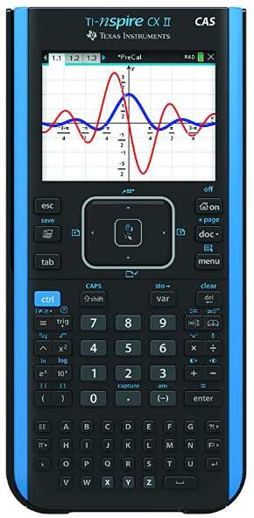
$$For the puposes of this presentation,$$
$$all the calculations will be done using$$
$$the TI CAS calculator as this will show all$$
$$the steps to get to the flight^{′}s speed and track.$$
$$Make sure the calculator is set to DEGREES mode.$$

Slide 29
$$To do these calculations repeatedly,$$
$$it is best to use a spreadsheet such as$$
$$MICROSOFT EXCEL or GOOGLE SHEETS$$
$$to automate these calculations.$$
$$Note:$$
$$Spreadsheets use$$
$$radians as the default$$
$$unit of angular measurement.$$
$$Examples:$$
=DEGREES(PI())
→ 180 degrees
$$To convert between radians and degrees,$$
$use the RADIANS and DEGREES functions$.
=RADIANS(45)
→ 0.7854 radians

Slide 30
$$2022 Flightradar24 Data Set used in the following examples$$
No. | Date (2022) | Flight No. | From | To | Lat 1 (decimal) | Long 1 (decimal) | Lat 2 (decimal) | Long 2 (decimal) | Δ Time (mm:ss) | Speed (kts) | Track (° True)
1 | 15 Jul | AV98 | SCL | BOG | -20.961 | -74.537 | -20.709 | -74.537 | 02:07 | 429 | 0
2 | 22 Jul | LA800 | AKL | SCL | -57.109 | -135.995 | -57.109 | -135.375 | 02:32 | 477 | 90
3 | 25 Jun | AF229 | EZE | CDG | 6.791 | -23.793 | 7.157 | -23.636 | 02:59 | 481 | 023
4 | 28 Jun | QF63 | SYD | JNB | -48.286 | 68.475 | -48.179 | 68.055 | 03:04 | 440 | 291
$$Input data$$
$$Objective$$

Slide 31
$$Method 1$$
$$Flight travelling$$
$$due north \left(000°T\right)$$
$$or due south (180°T)$$

Slide 32
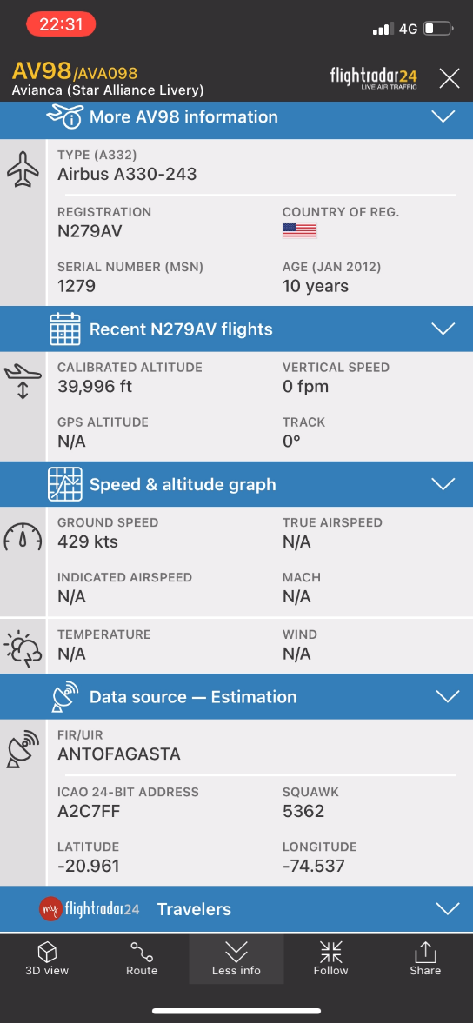
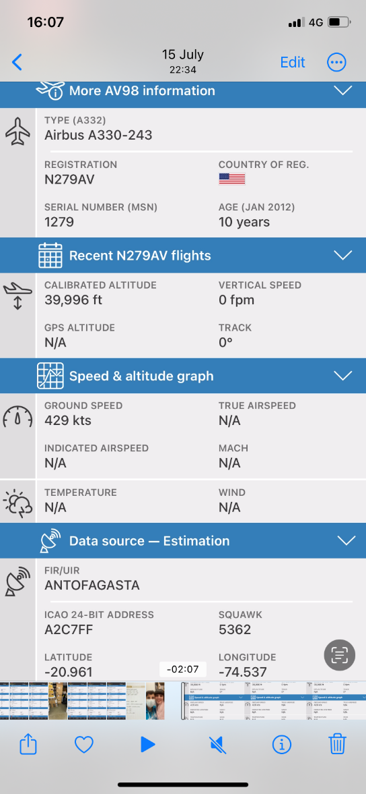
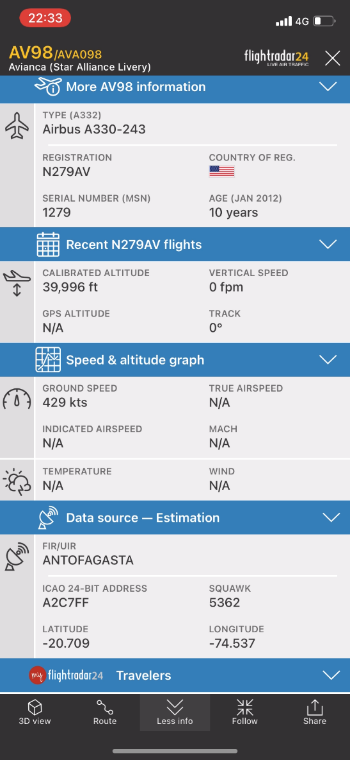
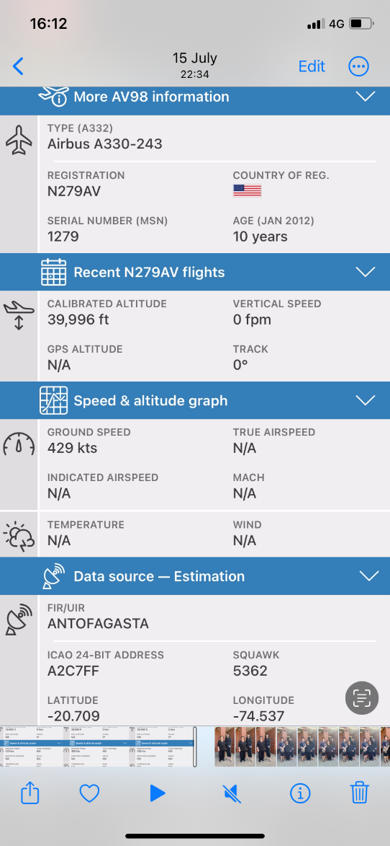
$$Data at the START of recording$$
$$Data at the END of recording$$

Slide 33
$$Method 1: Flight travelling north$$
Date | 2022-07-15
Flight Number | AV98
From | Santiago SCL
To | Bogota BOG
Latitude1 (degrees) | -20.961
Longitude1 (degrees) | -74.537
Latitude2 (degrees) | -20.709
Longitude2 (degrees) | -74.537
ΔTime (mm:ss) | 02:07
Speed (knots) | 429
Track ( ͦT ) | 000

Slide 34
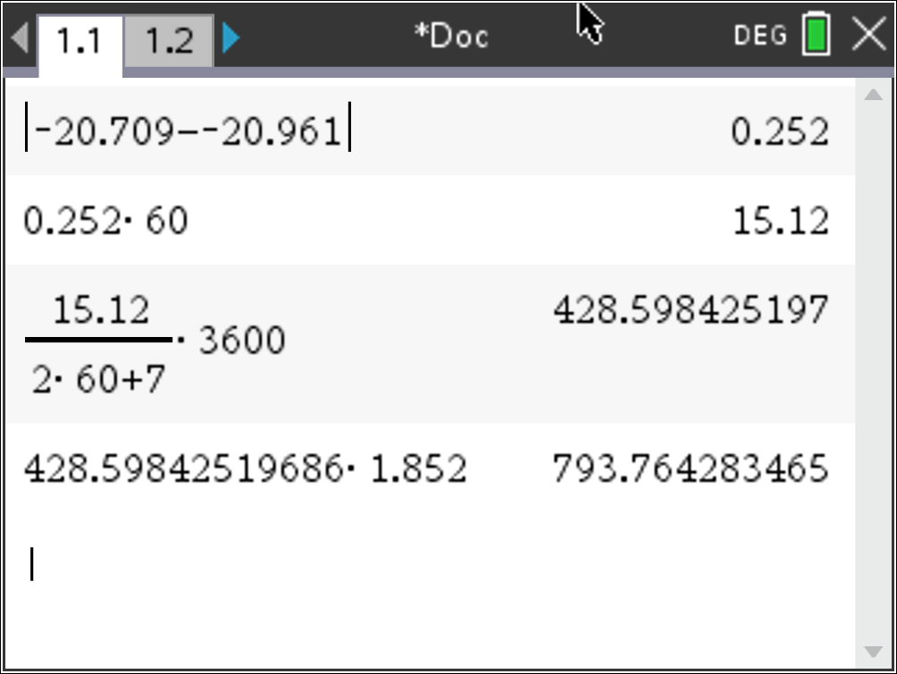
$$Method 1: Flight travelling north$$
Date | 2022-07-15
Flight Number | AV98
From | Santiago SCL
To | Bogota BOG
Latitude1 (degrees) | -20.961
Longitude1 (degrees) | -74.537
Latitude2 (degrees) | -20.709
Longitude2 (degrees) | -74.537
ΔTime (mm:ss) | 02:07
Speed (knots) | 429
Track ( ͦT ) | 000
$$Angle°$$
$$Distance in nm$$
$$Speed in knots$$
$$Speed in km/h$$

Slide 35
$$Method 1: Flight travelling north$$
Date | 2022-07-15
Flight Number | AV98
From | Santiago SCL
To | Bogota BOG
Latitude1 (degrees) | -20.961
Longitude1 (degrees) | -74.537
Latitude2 (degrees) | -20.709
Longitude2 (degrees) | -74.537
ΔTime (mm:ss) | 02:07
Speed (knots) | 429
Track ( ͦT ) | 000
$$Angle°$$
$$Distance in nm$$
$$Speed in knots$$
$$Speed in km/h$$

Slide 36
$$Method 1: Flight travelling north$$
Date | 2022-07-15
Flight Number | AV98
From | Santiago SCL
To | Bogota BOG
Latitude1 (degrees) | -20.961
Longitude1 (degrees) | -74.537
Latitude2 (degrees) | -20.709
Longitude2 (degrees) | -74.537
ΔTime (mm:ss) | 02:07
Speed (knots) | 429
Track ( ͦT ) | 000
$$Angle°$$
$$Distance in nm$$
$$Speed in knots$$
$$Speed in km/h$$

Slide 37
$$Method 1: Flight travelling north$$
Date | 2022-07-15
Flight Number | AV98
From | Santiago SCL
To | Bogota BOG
Latitude1 (degrees) | -20.961
Longitude1 (degrees) | -74.537
Latitude2 (degrees) | -20.709
Longitude2 (degrees) | -74.537
ΔTime (mm:ss) | 02:07
Speed (knots) | 429
Track ( ͦT ) | 000
$$Angle°$$
$$Distance in nm$$
$$Speed in knots$$
$$Speed in km/h$$

Slide 38
$$Method 1: Flight travelling north$$
Date | 2022-07-15
Flight Number | AV98
From | Santiago SCL
To | Bogota BOG
Latitude1 (degrees) | -20.961
Longitude1 (degrees) | -74.537
Latitude2 (degrees) | -20.709
Longitude2 (degrees) | -74.537
ΔTime (mm:ss) | 02:07
Speed (knots) | 429
Track ( ͦT ) | 000
$$Angle°$$
$$Distance in nm$$
$$Speed in knots$$
$$Speed in km/h$$
$$Speed ≈429 knots$$
$$Track =000° True ∵{Long}_{1}={Long}_{2} and {Lat}_{2} North of {Lat}_{1}$$

Slide 39
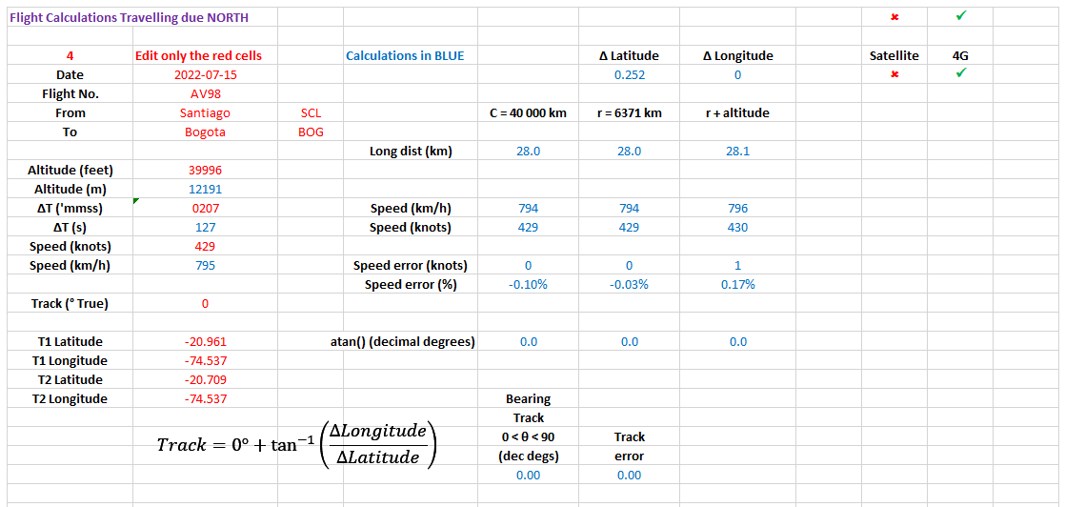

Slide 40
$$Method 2$$
$$Flight travelling$$
$$due east\left(090°T\right)$$
$$or due west (270°T)$$

Slide 41
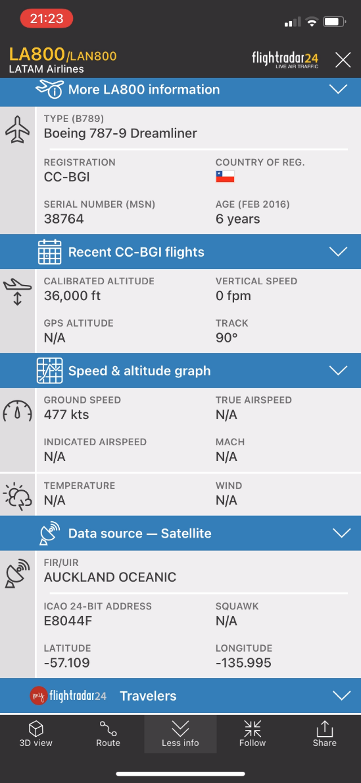
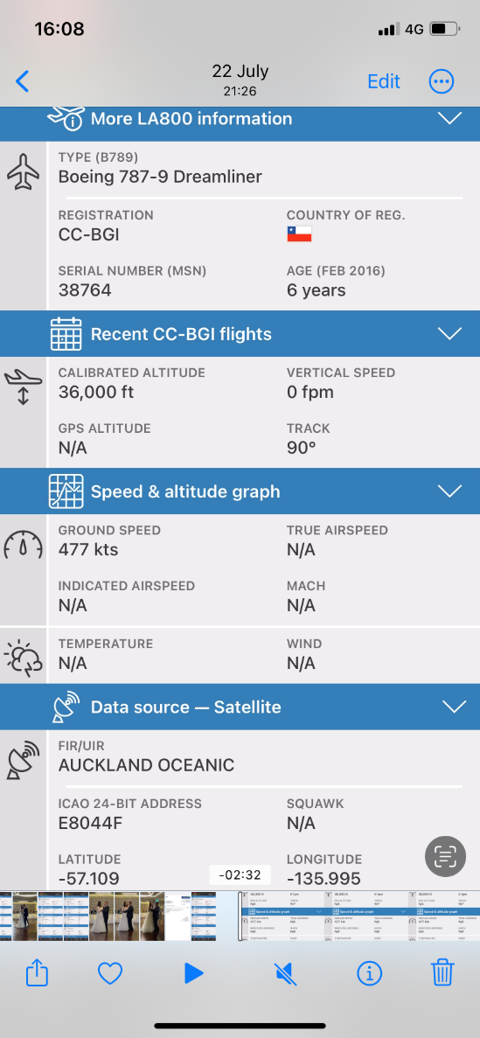
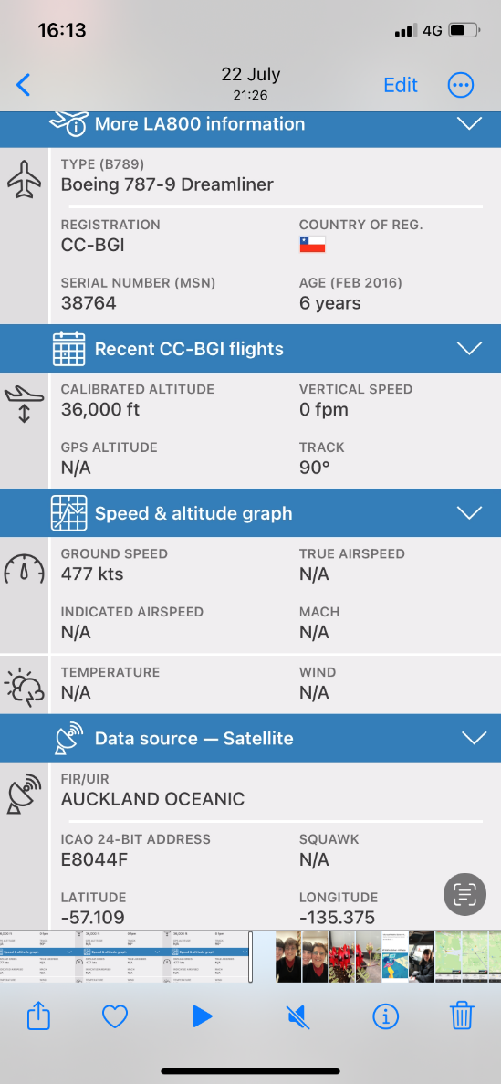
$$Data at the START of recording$$
$$Data at the END of recording$$

Slide 42
$$Method 2: Flight travelling east$$
Date | 2022-07-22
Flight Number | LA800
From | Auckland AKL
To | Santiago SCL
Latitude1 (degrees) | -57.109
Longitude1 (degrees) | -135.995
Latitude2 (degrees) | -57.109
Longitude2 (degrees) | -135.375
ΔTime (mm:ss) | 02:32
Speed (knots) | 477
Track ( ͦT ) | 090

Slide 43
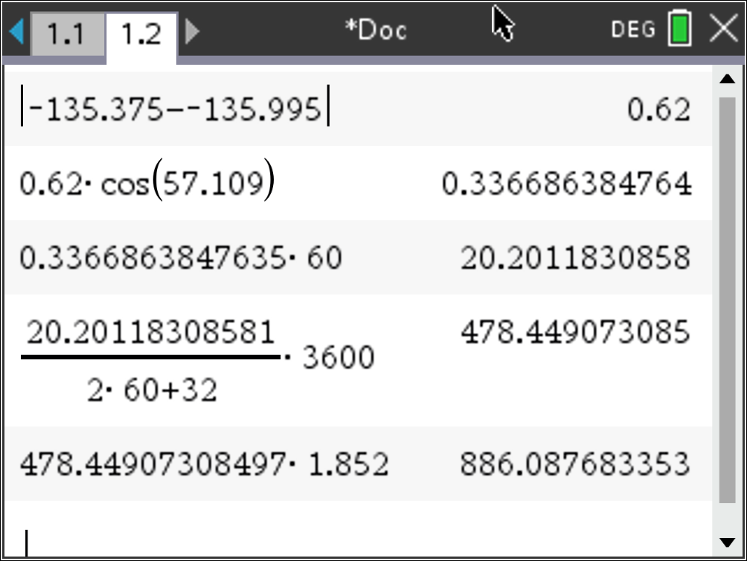
$$Method 2: Flight travelling east$$
Date | 2022-07-22
Flight Number | LA800
From | Auckland AKL
To | Santiago SCL
Latitude1 (degrees) | -57.109
Longitude1 (degrees) | -135.995
Latitude2 (degrees) | -57.109
Longitude2 (degrees) | -135.375
ΔTime (mm:ss) | 02:32
Speed (knots) | 477
Track ( ͦT ) | 090
$$Angle°$$
$$Angle × cos⁡(Lat°)$$
$$Distance in nm$$
$$Speed in knots⁡$$
$$Speed in km/h$$

Slide 44
$$Method 2: Flight travelling east$$
Date | 2022-07-22
Flight Number | LA800
From | Auckland AKL
To | Santiago SCL
Latitude1 (degrees) | -57.109
Longitude1 (degrees) | -135.995
Latitude2 (degrees) | -57.109
Longitude2 (degrees) | -135.375
ΔTime (mm:ss) | 02:32
Speed (knots) | 477
Track ( ͦT ) | 090
$$Angle°$$
$$Angle × cos⁡(Lat°)$$
$$Distance in nm$$
$$Speed in knots⁡$$
$$Speed in km/h$$

Slide 45
$$Method 2: Flight travelling east$$
Date | 2022-07-22
Flight Number | LA800
From | Auckland AKL
To | Santiago SCL
Latitude1 (degrees) | -57.109
Longitude1 (degrees) | -135.995
Latitude2 (degrees) | -57.109
Longitude2 (degrees) | -135.375
ΔTime (mm:ss) | 02:32
Speed (knots) | 477
Track ( ͦT ) | 090
$$Angle°$$
$$Angle × cos⁡(Lat°)$$
$$Distance in nm$$
$$Speed in knots⁡$$
$$Speed in km/h$$

Slide 46
$$Method 2: Flight travelling east$$
Date | 2022-07-22
Flight Number | LA800
From | Auckland AKL
To | Santiago SCL
Latitude1 (degrees) | -57.109
Longitude1 (degrees) | -135.995
Latitude2 (degrees) | -57.109
Longitude2 (degrees) | -135.375
ΔTime (mm:ss) | 02:32
Speed (knots) | 477
Track ( ͦT ) | 090
$$Angle°$$
$$Angle × cos⁡(Lat°)$$
$$Distance in nm$$
$$Speed in knots⁡$$
$$Speed in km/h$$

Slide 47
$$Method 2: Flight travelling east$$
Date | 2022-07-22
Flight Number | LA800
From | Auckland AKL
To | Santiago SCL
Latitude1 (degrees) | -57.109
Longitude1 (degrees) | -135.995
Latitude2 (degrees) | -57.109
Longitude2 (degrees) | -135.375
ΔTime (mm:ss) | 02:32
Speed (knots) | 477
Track ( ͦT ) | 090
$$Angle°$$
$$Angle × cos⁡(Lat°)$$
$$Distance in nm$$
$$Speed in knots⁡$$
$$Speed in km/h$$

Slide 48
$$Method 2: Flight travelling east$$
Date | 2022-07-22
Flight Number | LA800
From | Auckland AKL
To | Santiago SCL
Latitude1 (degrees) | -57.109
Longitude1 (degrees) | -135.995
Latitude2 (degrees) | -57.109
Longitude2 (degrees) | -135.375
ΔTime (mm:ss) | 02:32
Speed (knots) | 477
Track ( ͦT ) | 090
$$Angle°$$
$$Angle × cos⁡(Lat°)$$
$$Distance in nm$$
$$Speed in knots⁡$$
$$Speed in km/h$$
$$Speed ≈477 knots$$
$$Track =090° True ∵{Lat}_{1}={Lat}_{2} and {Long}_{2} East of {Long}_{1}$$

Slide 49
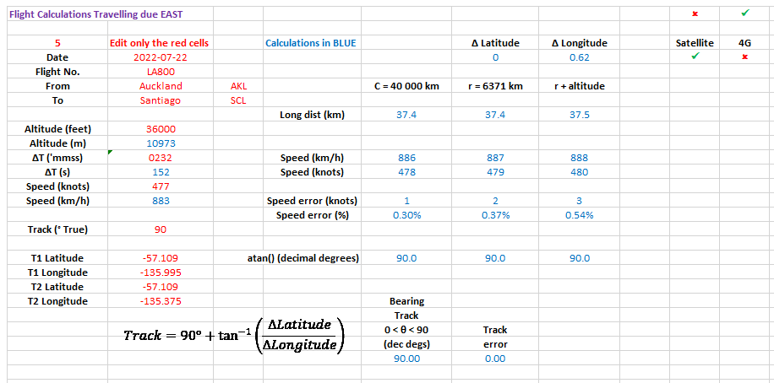

Slide 50
$$Method 3$$
$$Flight travelling in any direction$$
$$but within ±8° of the equator$$
$$Plane Trigonometry$$

Slide 51
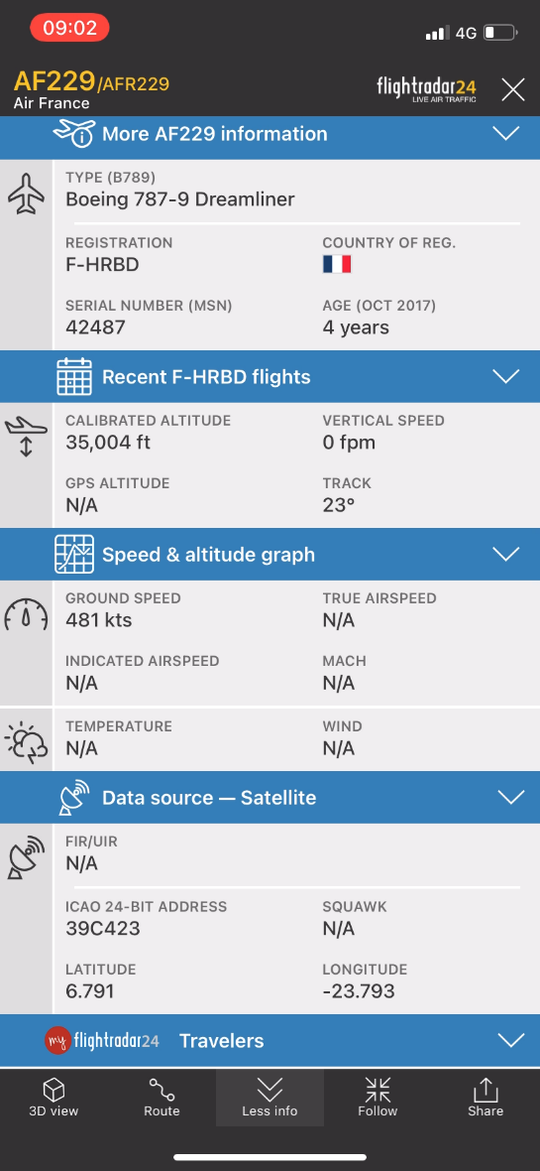
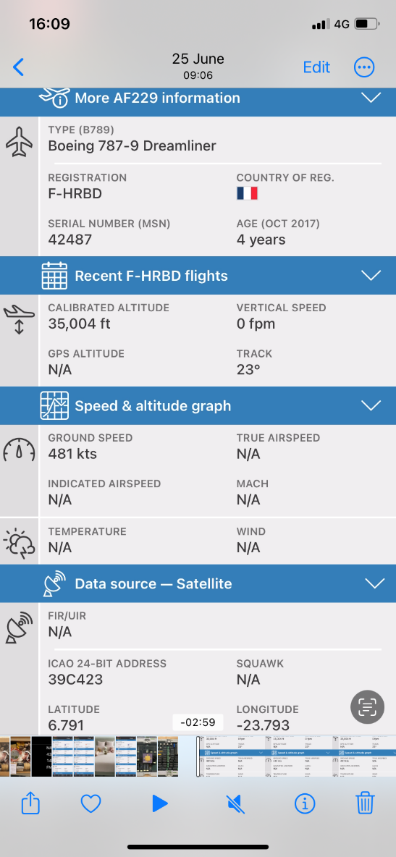
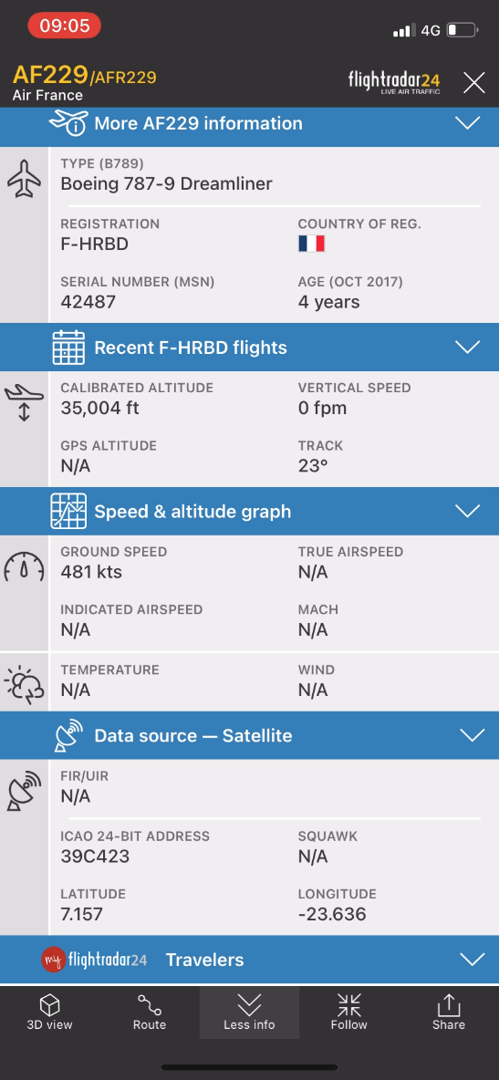
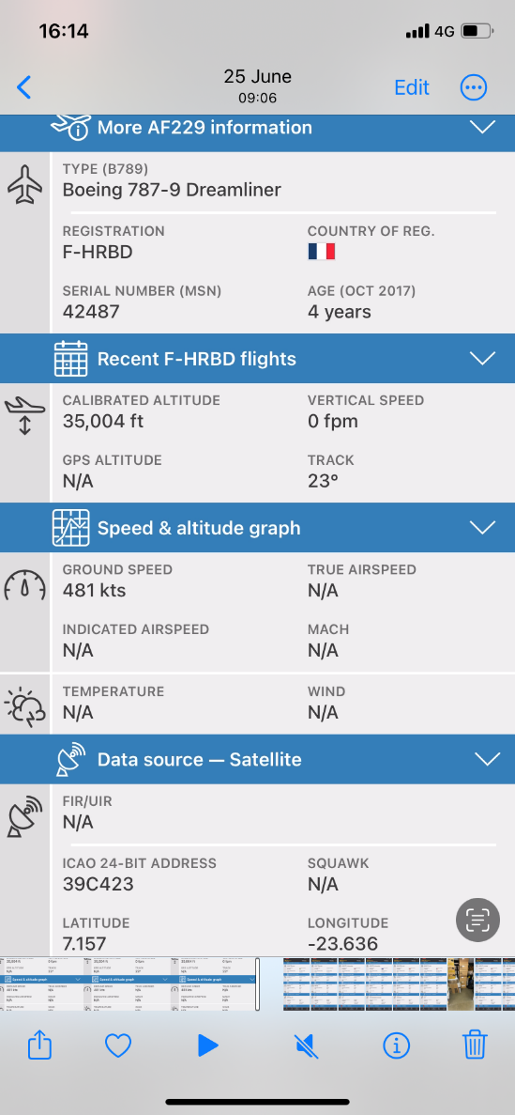
$$Data at the START of recording$$
$$Data at the END of recording$$

Slide 52
$$Method 3: Flight near the equator$$
Date | 2022-06-25
Flight Number | AF229
From | Buenos Aries EZE
To | Paris CDG
Latitude1 (degrees) | 6.791
Longitude1 (degrees) | -23.793
Latitude2 (degrees) | 7.157
Longitude2 (degrees) | -23.636
ΔTime (mm:ss) | 02:59
Speed (knots) | 481
Track ( ͦT ) | 023

Slide 53
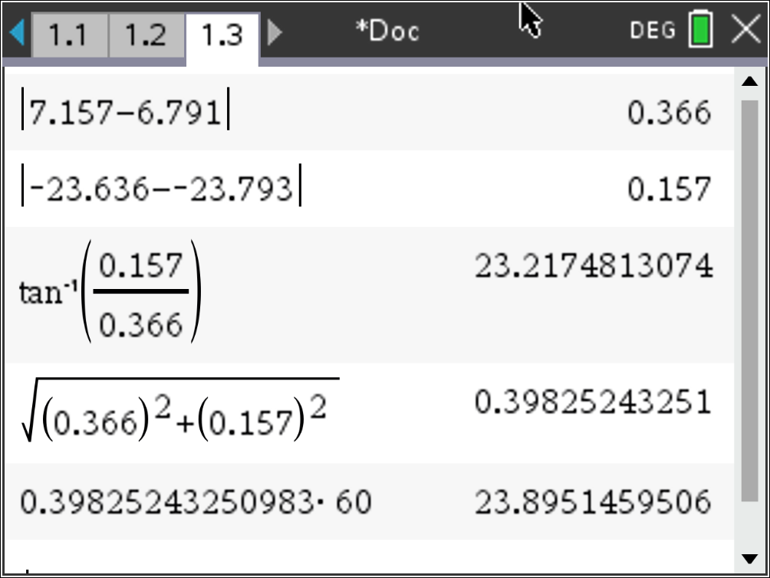
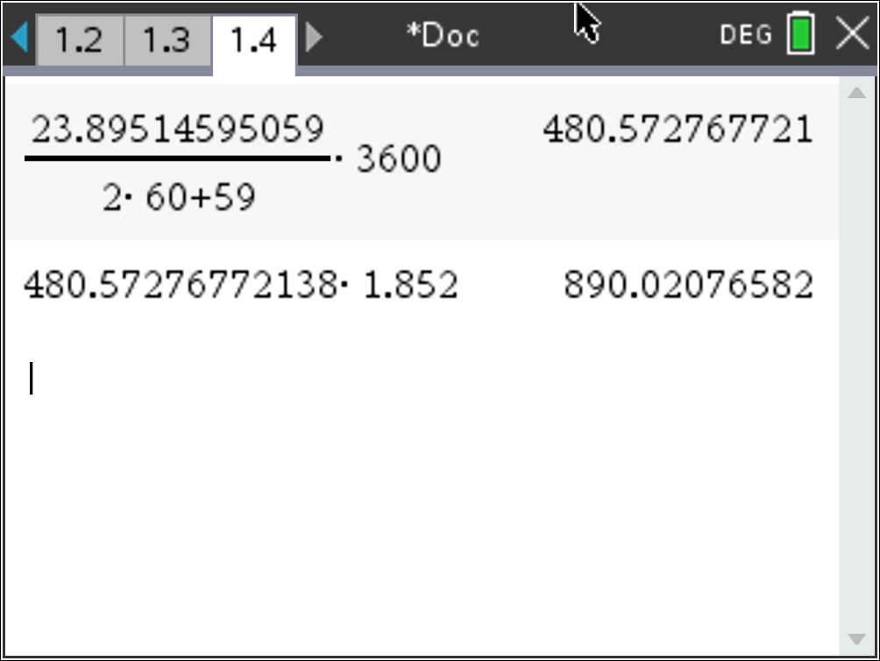
$$Method 3: Flight near the equator$$
$$∆Latitude$$
$$∆Longitude$$
Date | 2022-06-25
Flight Number | AF229
From | Buenos Aries EZE
To | Paris CDG
Latitude1 (degrees) | 6.791
Longitude1 (degrees) | -23.793
Latitude2 (degrees) | 7.157
Longitude2 (degrees) | -23.636
ΔTime (mm:ss) | 02:59
Speed (knots) | 481
Track ( ͦT ) | 023
$$Track =023° True$$
$$Distance as an angle$$
$$Distance(nm)$$
$$Speed(knots)$$
$$Speed(km/h)$$

Slide 54
$$Method 3: Flight near the equator$$
$$∆Latitude$$
$$∆Longitude$$
Date | 2022-06-25
Flight Number | AF229
From | Buenos Aries EZE
To | Paris CDG
Latitude1 (degrees) | 6.791
Longitude1 (degrees) | -23.793
Latitude2 (degrees) | 7.157
Longitude2 (degrees) | -23.636
ΔTime (mm:ss) | 02:59
Speed (knots) | 481
Track ( ͦT ) | 023
$$Track =023° True$$
$$Distance as an angle$$
$$Distance(nm)$$
$$Speed(knots)$$
$$Speed(km/h)$$

Slide 55
$$Method 3: Flight near the equator$$
$$∆Latitude$$
$$∆Longitude$$
Date | 2022-06-25
Flight Number | AF229
From | Buenos Aries EZE
To | Paris CDG
Latitude1 (degrees) | 6.791
Longitude1 (degrees) | -23.793
Latitude2 (degrees) | 7.157
Longitude2 (degrees) | -23.636
ΔTime (mm:ss) | 02:59
Speed (knots) | 481
Track ( ͦT ) | 023
$$Track =023° True$$
$$Distance as an angle$$
$$Distance(nm)$$
$$Speed(knots)$$
$$Speed(km/h)$$

Slide 56
$$Method 3: Flight near the equator$$
$$∆Latitude$$
$$∆Longitude$$
Date | 2022-06-25
Flight Number | AF229
From | Buenos Aries EZE
To | Paris CDG
Latitude1 (degrees) | 6.791
Longitude1 (degrees) | -23.793
Latitude2 (degrees) | 7.157
Longitude2 (degrees) | -23.636
ΔTime (mm:ss) | 02:59
Speed (knots) | 481
Track ( ͦT ) | 023
$$Track =023° True$$
$$Distance as an angle$$
$$Distance(nm)$$
$$Speed(knots)$$
$$Speed(km/h)$$

Slide 57
$$Method 3: Flight near the equator$$
$$∆Latitude$$
$$∆Longitude$$
Date | 2022-06-25
Flight Number | AF229
From | Buenos Aries EZE
To | Paris CDG
Latitude1 (degrees) | 6.791
Longitude1 (degrees) | -23.793
Latitude2 (degrees) | 7.157
Longitude2 (degrees) | -23.636
ΔTime (mm:ss) | 02:59
Speed (knots) | 481
Track ( ͦT ) | 023
$$Track =023° True$$
$$Distance as an angle$$
$$Distance(nm)$$
$$Speed(knots)$$
$$Speed(km/h)$$

Slide 58
$$Method 3: Flight near the equator$$
$$∆Latitude$$
$$∆Longitude$$
Date | 2022-06-25
Flight Number | AF229
From | Buenos Aries EZE
To | Paris CDG
Latitude1 (degrees) | 6.791
Longitude1 (degrees) | -23.793
Latitude2 (degrees) | 7.157
Longitude2 (degrees) | -23.636
ΔTime (mm:ss) | 02:59
Speed (knots) | 481
Track ( ͦT ) | 023
$$Track =023° True$$
$$Distance as an angle$$
$$Distance(nm)$$
$$Speed(knots)$$
$$Speed(km/h)$$

Slide 59
$$Method 3: Flight near the equator$$
$$∆Latitude$$
$$∆Longitude$$
Date | 2022-06-25
Flight Number | AF229
From | Buenos Aries EZE
To | Paris CDG
Latitude1 (degrees) | 6.791
Longitude1 (degrees) | -23.793
Latitude2 (degrees) | 7.157
Longitude2 (degrees) | -23.636
ΔTime (mm:ss) | 02:59
Speed (knots) | 481
Track ( ͦT ) | 023
$$Track =023° True$$
$$Distance as an angle$$
$$Distance(nm)$$
$$Speed(knots)$$
$$Speed(km/h)$$

Slide 60
$$Method 3: Flight near the equator$$
$$∆Latitude$$
$$∆Longitude$$
Date | 2022-06-25
Flight Number | AF229
From | Buenos Aries EZE
To | Paris CDG
Latitude1 (degrees) | 6.791
Longitude1 (degrees) | -23.793
Latitude2 (degrees) | 7.157
Longitude2 (degrees) | -23.636
ΔTime (mm:ss) | 02:59
Speed (knots) | 481
Track ( ͦT ) | 023
$$Track =023° True$$
$$Distance as an angle$$
$$Distance(nm)$$
$$Speed(knots)$$
$$Speed(km/h)$$
$$Speed ≈481 knots$$

Slide 61
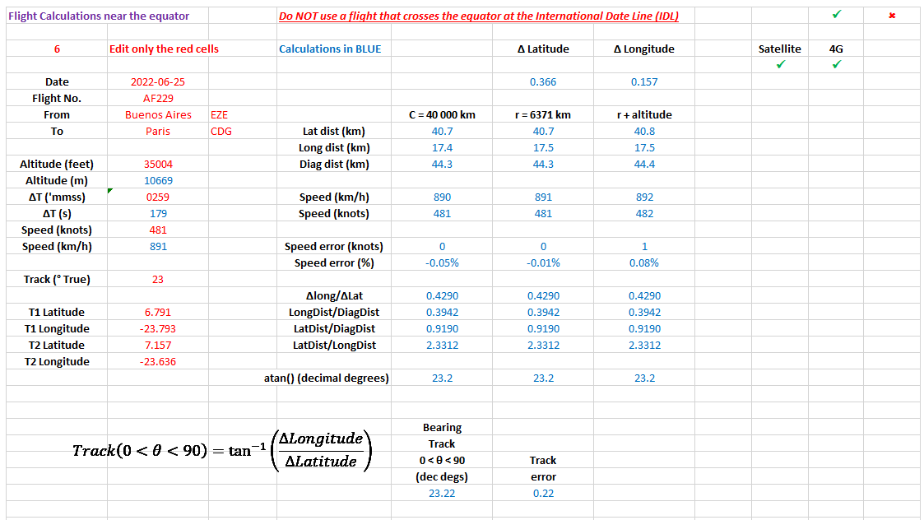

Slide 62
$$Method 4$$
$$Flight travelling in$$
$$any direction and$$
$$anywhere on the Earth$$
$$Spherical Trigonometry$$

Slide 63
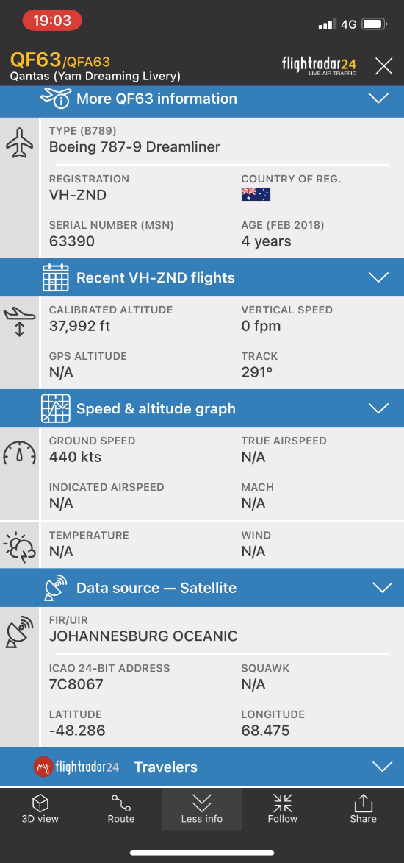
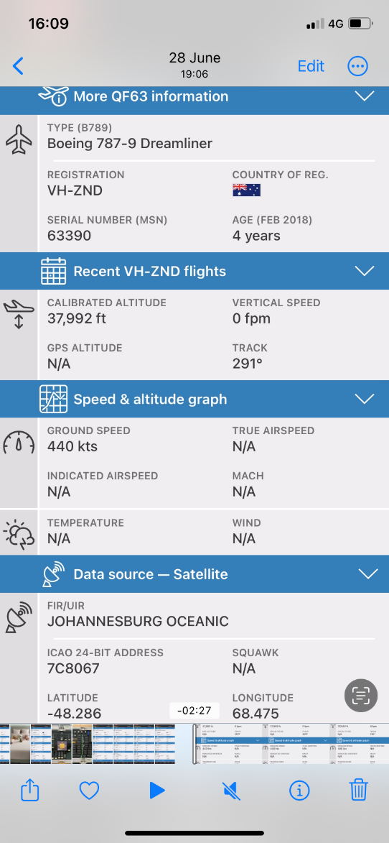
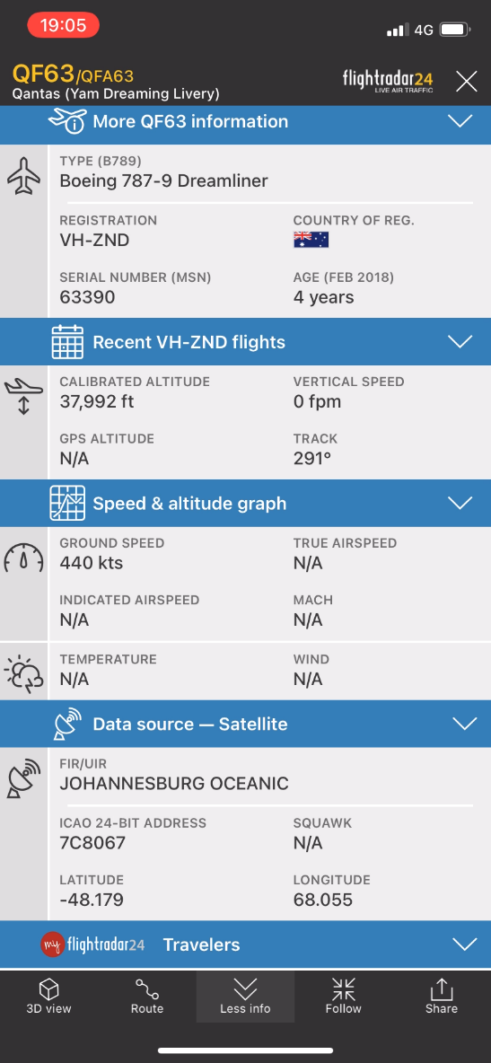
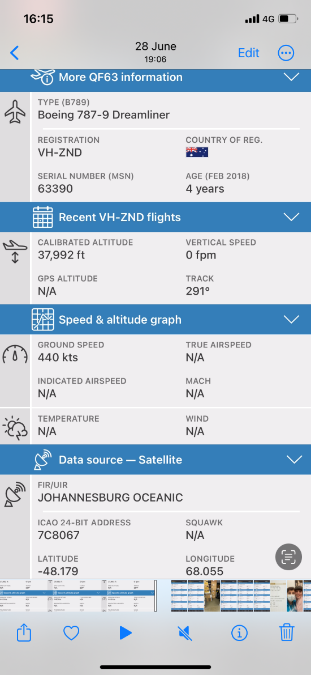
$$Data at the START of recording$$
$$Data at the END of recording$$

Slide 64
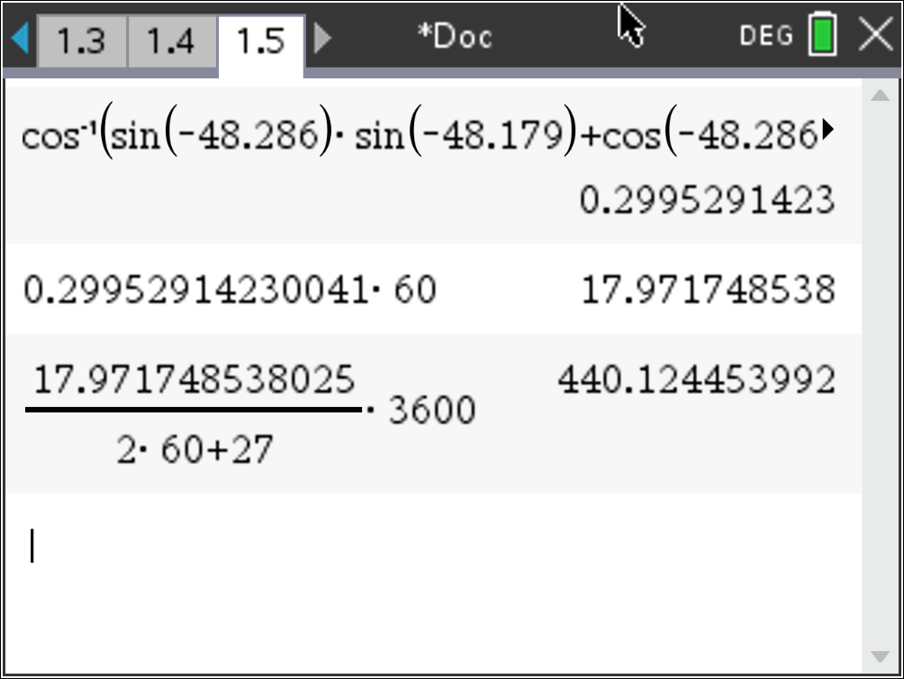
$$Calculating the$$
$$angle, distance \& speed$$
$$Method 4:Spherical trigonometry$$
Date | 2022-06-28
Flight Number | QF63
From | Sydney SYD
To | Jo’burg JNB
Latitude1 (degrees) | -48.286
Longitude1 (degrees) | 68.475
Latitude2 (degrees) | -48.179
Longitude2 (degrees) | 68.055
ΔTime (mm:ss) | 02:27
Speed (knots) | 440
Track ( ͦT ) | 291
$$arc angle(°)$$
$$distance(nm)$$
$$speed(knots)$$
$$Speed ≈440 knots$$
$$arc angle=\cos^{−1}\left[\sin\left({Lat}_{1}\right)∙\sin\left({Lat}_{2}\right)+\cos\left({Lat}_{1}\right)∙\cos\left({Lat}_{2}\right)∙\cos\left(\left|{Long}_{2}−{Long}_{1}\right|\right)\right]$$

Slide 65
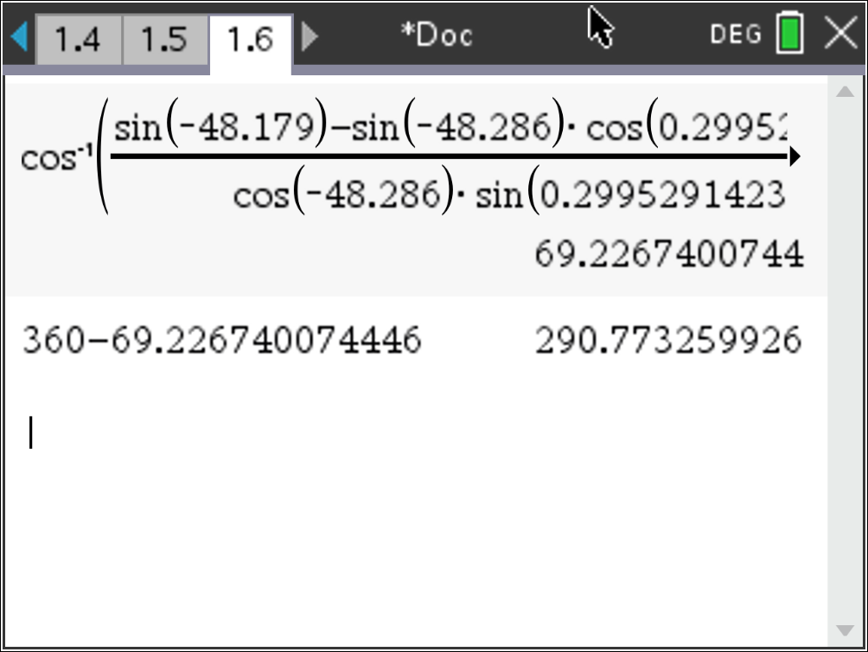
$$Method 4:Spherical trigonometry$$
$$Calculating the track$$
Date | 2022-06-28
Flight Number | QF63
From | Sydney SYD
To | Jo’burg JNB
Latitude1 (degrees) | -48.286
Longitude1 (degrees) | 68.475
Latitude2 (degrees) | -48.179
Longitude2 (degrees) | 68.055
ΔTime (mm:ss) | 02:27
Speed (knots) | 440
Track ( ͦT ) | 291
$$θ°=\cos^{−1}\left(\frac{\sin\left({Lat}_{2}\right)−\sin\left({Lat}_{1}\right)\cos\left(arc angle\right)}{\cos\left({Lat}_{1}\right)\sin\left(arc angle\right)}\right)$$
$$θ°=$$
$$Track$$
$$correction$$
$$If {Lon}_{2}>{Lon}_{1} then Track=θ°$$
$$✗$$
$$Track=291° T$$
$$If {Lon}_{2}<{Lon}_{1} then Track=360°−θ°$$
$$✓$$

Slide 66
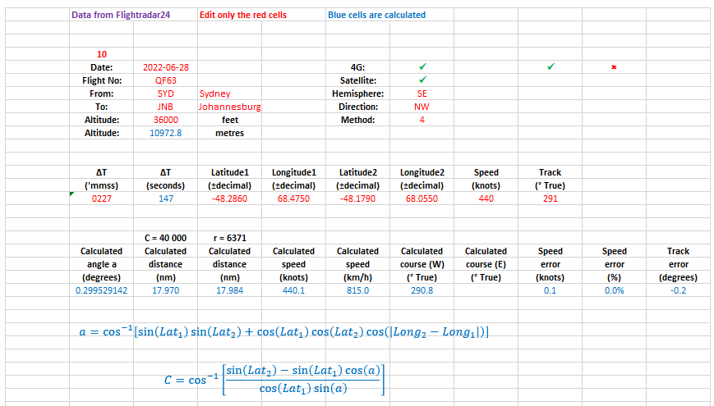

Slide 67
$$Who said trigonometry is useless‼!$$
$$Navigation is a very practical$$
$$application of trigonometry.$$
$$Thank you.$$
$$The End$$

Slide 68
References:
Bowditch, N. and United States National Geospatial-Intelligence Agency (2013).
The American Practical Navigator. New York, NY: Skyhorse.
Wikipedia Contributors. (2020, October 13). Great-circle distance. Retrieved November 2, 2020, from Wikipedia website: https://en.wikipedia.org/wiki/Great-circle_distance#:~:text=The%20great%2Dcircle%20distance%2C%20orthodromic,line%20through%20the%20sphere’s%20interior).

Slide 69
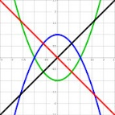
Enzo Vozzo
After working as a Technical Officer at Telstra, Enzo graduated from Monash University in 2005
with a Bachelor of Technology (Computer Studies) and taught Electronics and Communications
Engineering at Chisolm TAFE.
In 2013 he graduated from RMIT University with a Graduate Diploma of Education teaching
Secondary School Mathematics and Science.
Since 2016 he has been teaching Mathematics at Mentone Grammar.
Email: exv@mentonegrammar.net
Instagram: iphiepi: https://www.instagram.com/iphiepi/
YouTube Channel: Maths Whenever:
https://www.youtube.com/channel/UCFLdfe_y2OQ1MZvGjha9taQ/videos
$$i=\sqrt{−1}$$
$$φ=\frac{1+\sqrt{5}}{2}$$
$$e=\sum_{n=0}^{∞}{\frac{1}{n!}}$$
$$π=4\int_{0}^{1}{\sqrt{1−x^{2}}}dx$$

